Slide 1
My Team Taher Ali Abhay Singh Hada
Guide Name Mr. Sanjay Rathore
Mr. Ankush Sharma

Slide 2
Project Project Name - Examination-Portal
Brief Intro about project
It’s based on online examination system. Today every one has less time so it’s very helpful for both Teachers and Students that they can easily create and join exam in this website. They do not have to be physically present in exam hall to give exam.

Slide 3
Language & Framework We Use
For Front End
HTML5
CSS3
BOOTSTRAP3
JAVASCRIPT
ANGULAR
TYPESCRIPT
For Back End
JAVASCRIPT
EXPRESS.JS
NODE.JS
For Database
MONGO DB ATLAS
For SHARING
GIT
GITHUB

Slide 4
Teacher
Create Test
Add Q From Q Bank
Add Q Manually
Create Q bank
View All Result
Student
Join Test
View Result
Read Q Bank

Slide 5
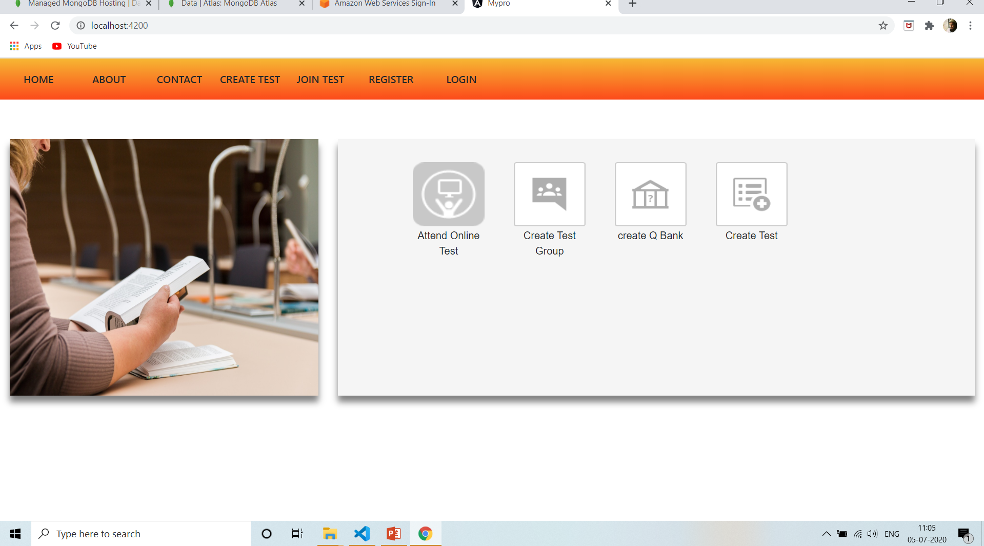
HOME PAGE

Slide 6
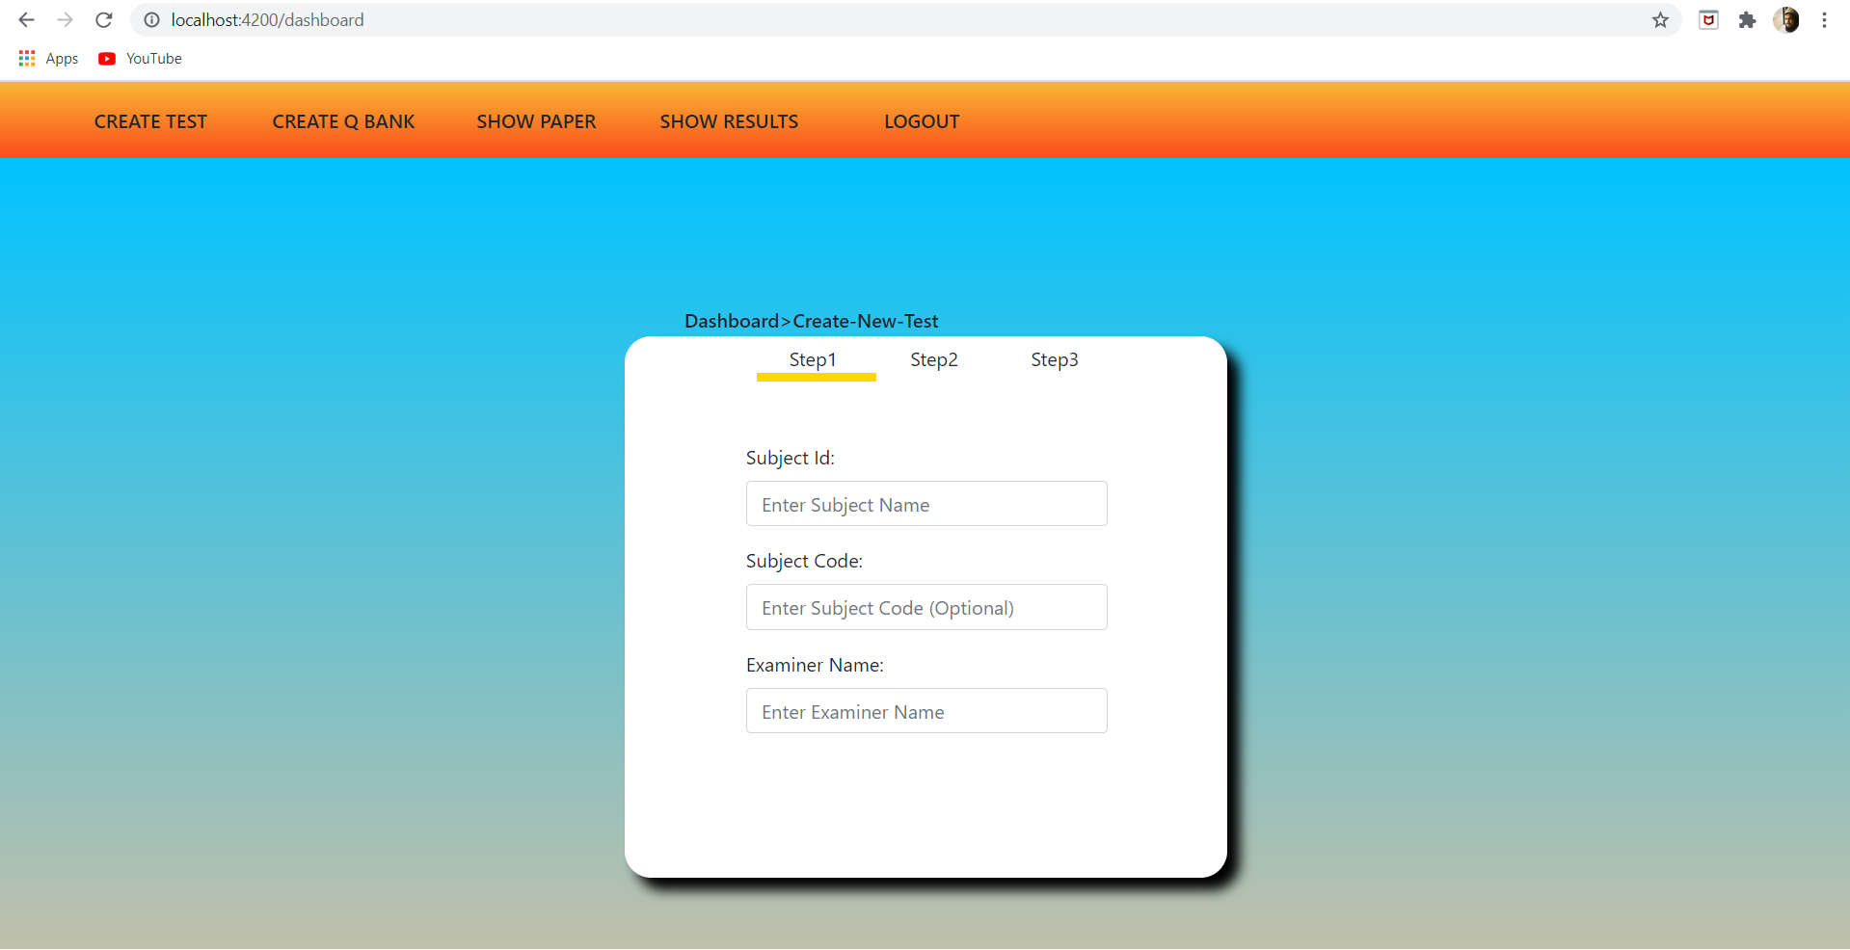
TEACHER ACCOUNT

Slide 7
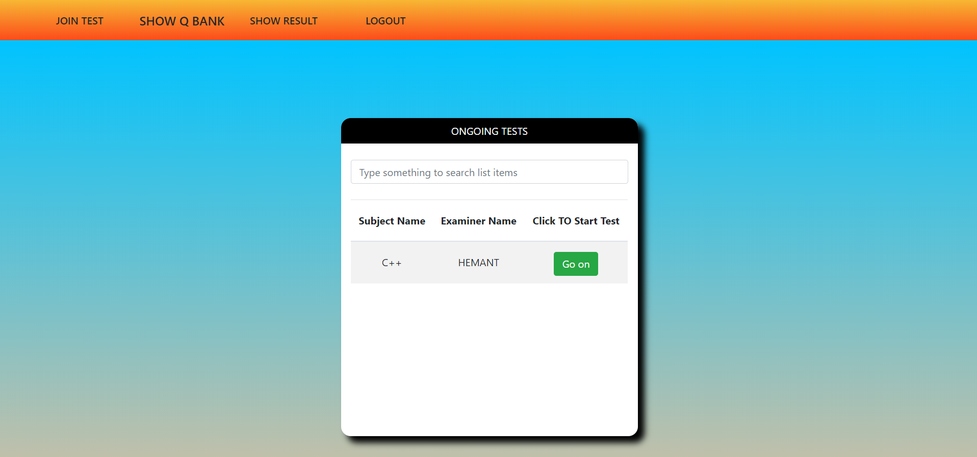
STUDENT ACCOUNT

